Slide 1
CUSTOMER ONBOARDING

Slide 2

Smart SPEND

Slide 3
Customer Onboarding is the process of introducing and integrating new customers into a business, product or service.
The goal of customer onboarding is to familiarize new customers with the benefits, features and functionality of the product or service they have purchased or subscribed to. It is the process of making the customer feel welcomed, informed and supported from the start of their relationship with the business.
The customer onboarding process typically involves a series of steps, such as account setup, product/service orientation, training, and ongoing support to ensure the customer is fully equipped to use the product or service. Effective customer onboarding can improve customer satisfaction, increase product adoption rates, and reduce customer churn.

Slide 4
MIND MAP
REST
BASED
API
ENCRYPTION
DECRYPTION
UTILITY
DATABASE
RDBMS
NoSQL
EVENT
STREAMING
KAFKA/KINESIS
MONITORING OR
ALERTING
TOOL

Slide 5
IDEA
Objective
Application
Implementation

Slide 6
OBJECTIVE
The objective of customer onboarding is to create a positive first impression and ensure that new customers have a smooth and successful experience with your product or service.
This process typically involves guiding customers through the initial steps of using your product or service, educating them on its features and benefits, and answering any questions or concerns they may have. The ultimate goal is to help customers achieve their desired outcomes and build a long-term relationship with your business. Effective customer onboarding can lead to higher customer satisfaction, increased retention, and ultimately, improved business performance.
Other objectives:-
Reducing customer churn
Increasing customer satisfaction
Accelerating time to value
Gathering feedback

Slide 7
IMPLEMENTATION
Define your customer onboarding goals and objectives: Start by identifying what you want to achieve with your onboarding process.
Map out the customer journey: Develop a detailed understanding of the customer journey, from initial sign-up to ongoing usage and beyond.
Develop an onboarding plan: Based on your goals and customer journey, create a detailed onboarding plan that outlines the specific steps and actions that need to be taken to ensure a successful onboarding experience.
Create onboarding materials: Develop a range of onboarding materials that are designed to educate and support customers throughout the onboarding process. This could include product tutorials, user guides, FAQs, or video tutorials.
Assign roles and responsibilities: Identify who will be responsible for delivering each aspect of the onboarding process, and ensure that everyone involved understands their role and responsibilities.
Monitor and measure success: Regularly monitor and measure the success of your onboarding process using metrics such as customer satisfaction, time to value, and churn rate.

Slide 8
APPLICATION
Customer onboarding can be applied in a wide range of industries and contexts, including:
Software as a Service (SaaS) companies: SaaS companies can use onboarding to help new customers get up to speed with their software quickly, reducing churn and accelerating time to value.
E-commerce businesses: E-commerce companies can use onboarding to help new customers understand their product offerings, learn about the buying process, and feel confident in their purchases.
Financial services: Financial services companies can use onboarding to help new customers understand their financial products and services, as well as any associated fees, charges, or requirements.
Healthcare: Healthcare providers can use onboarding to help new patients understand their medical conditions, treatment options, and care plans, as well as any necessary administrative procedures.
Education: Educational institutions can use onboarding to help new students understand the curriculum, expectations, and resources available to them, as well as any necessary administrative procedures.

Slide 9
How are we going to do…
Our App is used to fetch the Customer Details (Demographic Details) such as Names, Address, Contact details (Email, Mobile Number and basic customer details which includes Gender, Date Of Birth, Id Details).
To make this possible we use the technology REST Based API, Database, Encryption and Decryption Tools and Event
Streaming viz Kafka and Kinesis , and the most important Monitoring Tools or Alerting Tools.

Slide 10
HOW IT’S USER FRIENDLY
Everything becomes the Best only when we use the Resources in the OPTIMUM condition
When we say BEST, that means
It provides more Security,
It has less Time Complexity,
It is more Functionable being the most Simple,
It has User-Friendly Interface,
The software is flexible enough to meet the wide range of Users,
It has high and smooth performance even under heavy use,
It is Scalable and is able to handle the increasing number of Users,
It should provide regular updates and support, with timely bug fixes.

Slide 11
PLATFORM AND DEVELOPMENT TOOL
The tool that we are using for the development of this app is EXPO Snack. Expo Snack is an open-source platform for running React Native apps in the browser. It dynamically bundles and compiles code and runs it in the Expo Go or in a web-player.
Code can be saved as "Snacks" and can be easily shared with others. We will be used the EXPO Snack tool and the language we are using is Node.js is a platform built on Chrome's JavaScript runtime for easily building fast and scalable network applications.
Node.js uses an event-driven, non-blocking I/O model that makes it lightweight and efficient, perfect for data-intensive real-time applications that run across distributed devices.

Slide 12
ESSENTIAL FEATURES
Account Management
Account Overview, Account Details, Account Settings, Account Support etc.
Security
Authentication, Encryption, Secure Storage, Session Management, Malware prevention etc.
Bill Payments
Billers, Payment Options, Schedule Payment, Payment History, Payment Alerts etc.
Mobile Check Deposit
5. Customer Support
In-app chat support, Phone and Email Support, FAQs, Video Tutorials etc.

Slide 13
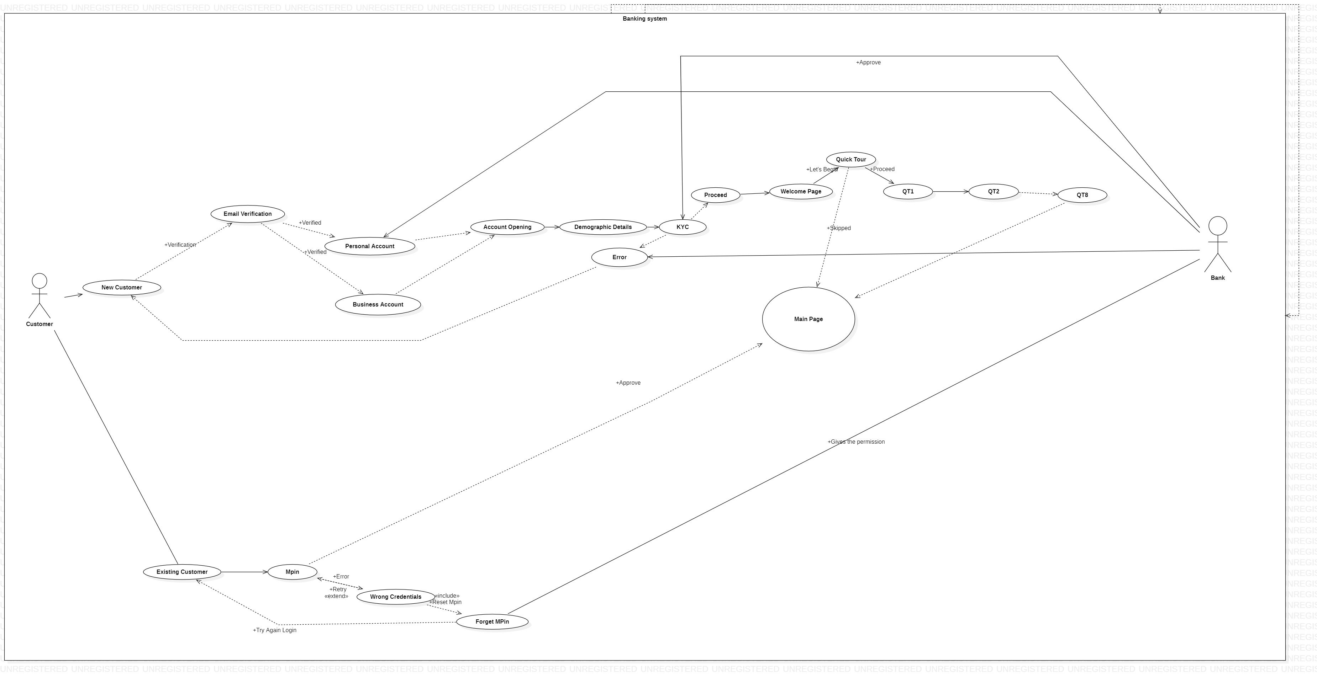
USE CASE DIAGRAM

Slide 14
Spend SMART
Aditya Dey
Ginnela Jayadeep
Yeddula Bharath Simha

